Slide 1

Infinity API 101
An Intro to Infinity API
Adam Forester
API Dude

Slide 2
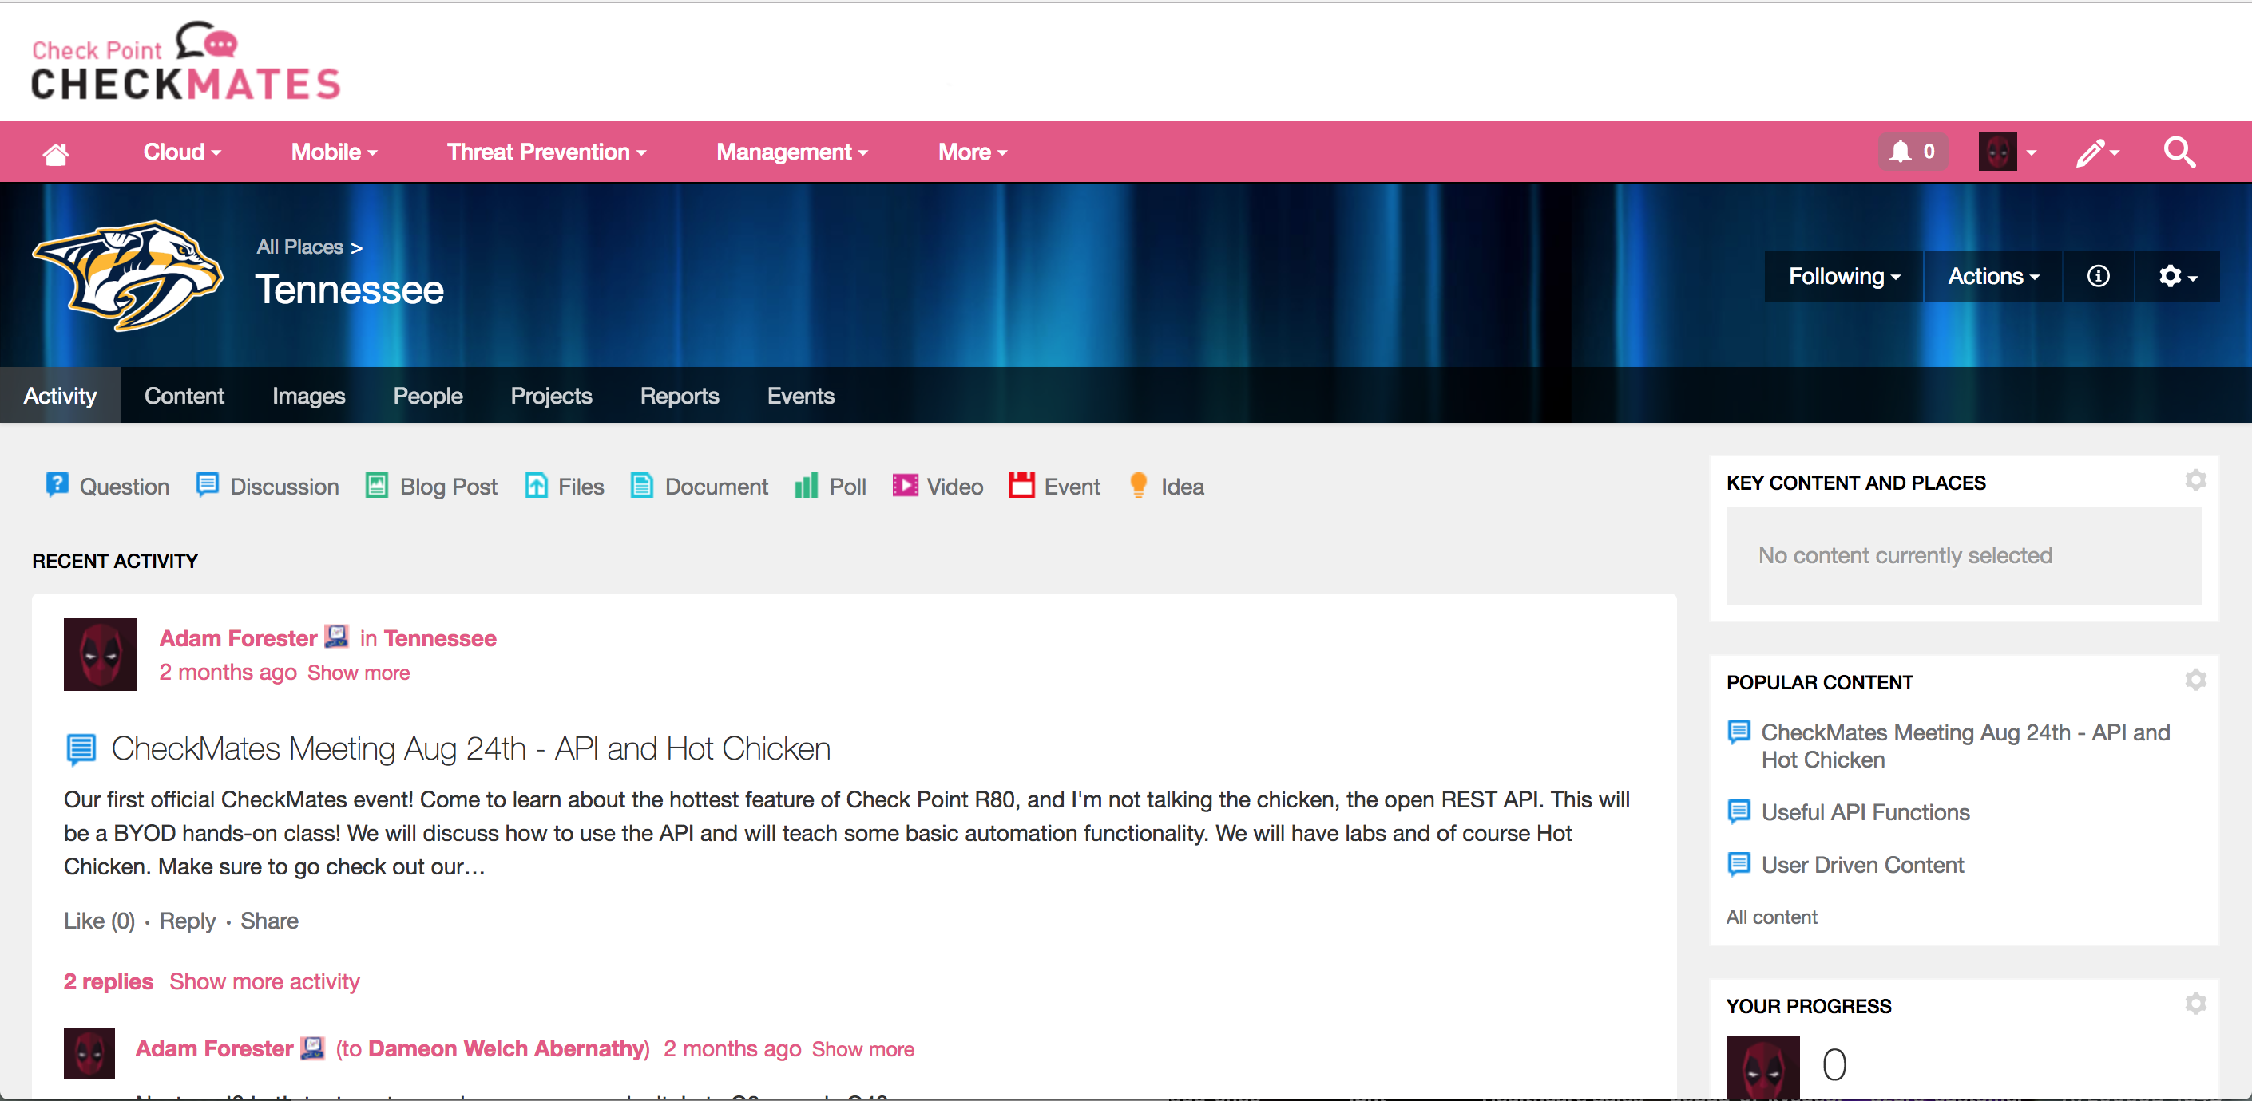

Slide 3
Agenda
What is an API?
Automation vs Orchestration
The INFINITY API
The Beginners Guide to API
Advanced Shell Scripting
JSON and JQ
Ansible

Slide 4
What is this “API” you speak of?? And why is it always RESTing?!?

Slide 5
In short…
An API is a means by which to interact with a computer system or software…

Slide 6
Or, as reported by Dr. Google
In computer programming, an application programming interface (API) is a set of routines, protocols, and tools for building software applications. An API expresses a software component in terms of its operations, inputs, outputs, and underlying types.
APIs - Wikipedia
https://en.wikipedia.org/wiki/Application_programming_interface

Slide 7
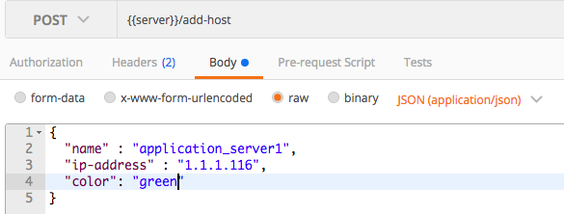

Get some REST!
Is the mechanism that allows for systems to access , manipulate , delete , change , add resources on an application via web services.
Rest APIs are called via standard URLs , for example:
https://r80-mgmt/web_api/add_host
The application exposes HTML calls such as : get/post/put/delete , etc.
The data being exchanged can be in formats such as:
HTML , JSON , XML.
R80 SmartCenter/MDM
https://r80mgmt/web_api/add_host

Slide 8
Automation
Vs
Orchestration

Slide 9
Automation
is concerned with a single task – launching a web server, configuring a web server, stopping a service, etc., in a repeatable, consistent manner. Automation is about laying a building block of consistent, predictable content.

Slide 10
Orchestration
is concerned with automating the execution of a workflow – of a process. Orchestration is the choreography of a series of (automated) tasks – putting the tasks together into a logical series (workflow).

Slide 11
Check Point Automation Solutions

Slide 12

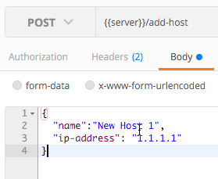
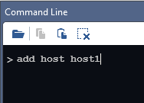
Flexible and Powerful Automation – R80
Web Services API
Mgmt CLI
SmartConsole Command Line
[Expert@r80mgmt:0]# mgmt_cli login
Rest APIs / JSON format
Shell Scripting
Faster Operations
API Guide : https://sc1.checkpoint.com/documents/latest/APIs/index.html

Slide 13
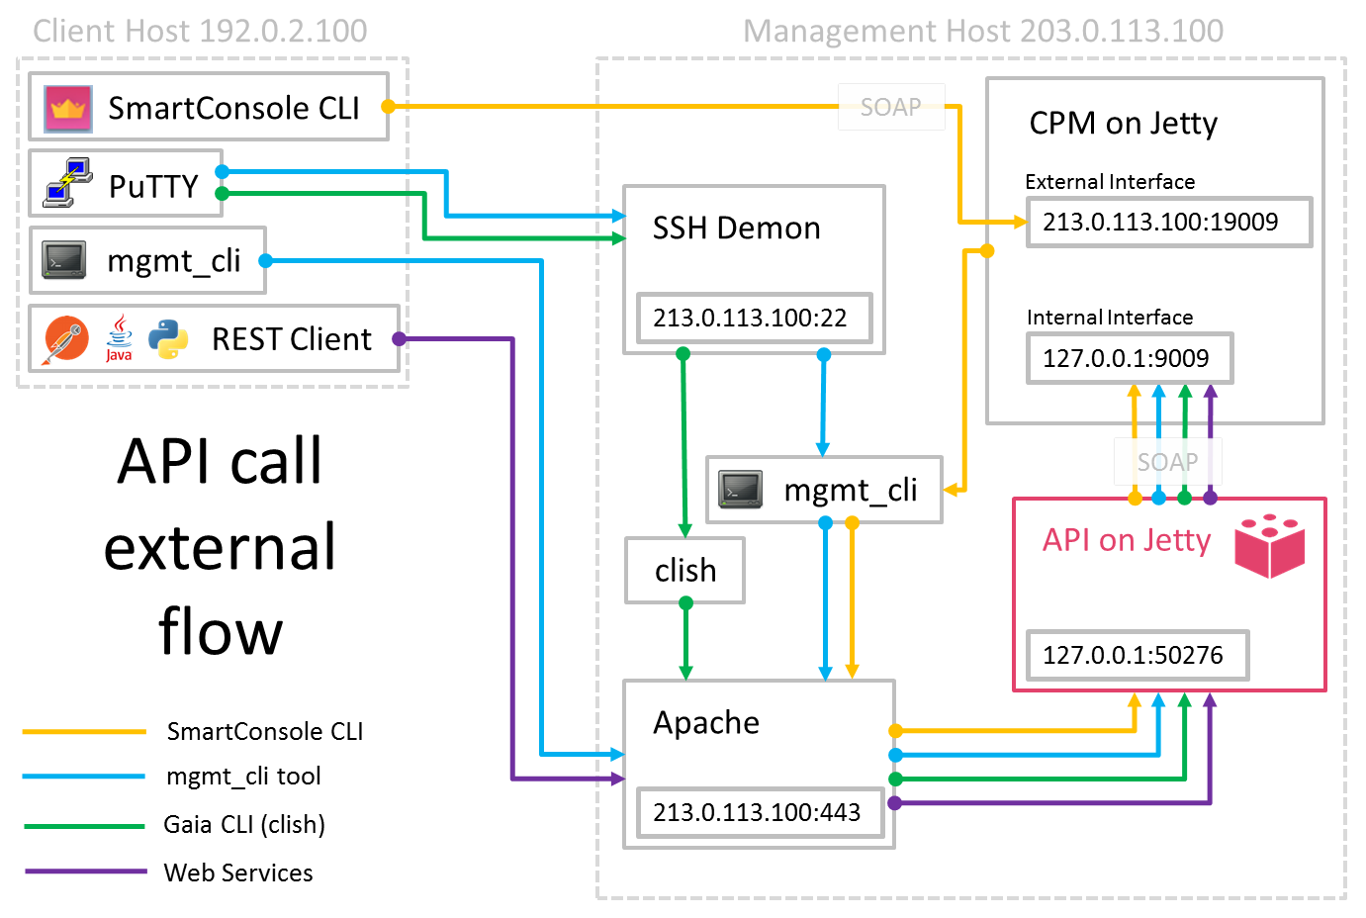
R80 Architecture

Slide 14
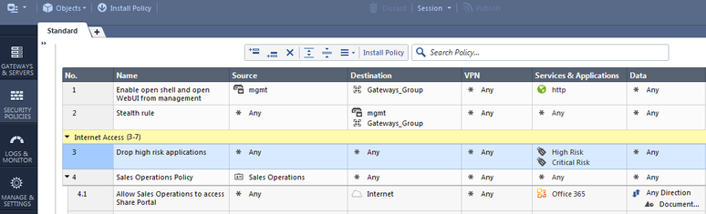
Operational Efficiencies
Change Request Automation
Automation Tools
Self Service Portal
SECURITY MANAGEMENT
Rest API
✓
New Objects
RuleBase Efficiency
✓
New Rules
…....

Slide 15
What would I use this for??

Slide 16


Slide 17
Use Cases
Adding massive amounts of objects
Modifying Objects
Automated Deployment of Gateways
Auto-remediation (SmartEvent)
Base Policy build
Cleanup
Really…. Everything…

Slide 18
Automation Security and Flexibility (Insert DEVOPS Buzzword)
API tasks/processes can be applied to specific sections of the policy
No need for admin rights to every part of the policy
Granular privileges to policy layers
Access is granted based on the same trusted clients as a GUI client
Access can be any method from the client
Restrictions on API use for normal GUI users
Locks on the database are minimized by use of sessions

Slide 19

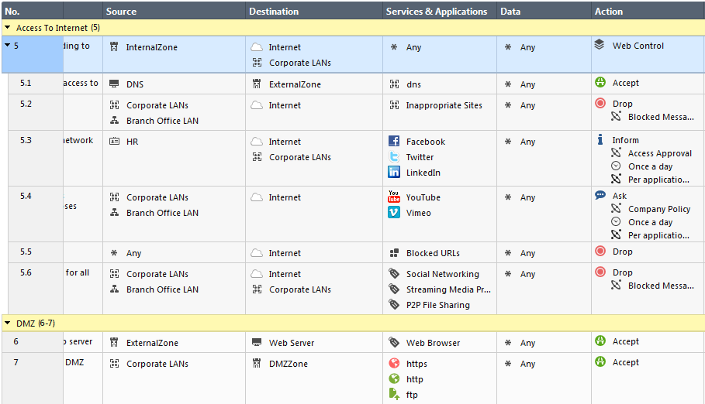

Delegation with Inline Layer
John still has full admin privilage on Parent Rule
Subpolicies or inline layers are ideal for delegation.
Delegate subpolicy to API User
Notes:
sub-policy
1) Performace
2) Like sections but with enforcement
3) delegation (currently lacking becuase the delegated anmin can change all objects). If we delegate the parent rule, we miss the point of delegation because we give the admin full power...
4) zone based policy++
5) sharing.
Note: In Profile permission the Common Objects are currently by default set to Read for custom profiles The R/W permission is for all objects and NOT per layer or a container of objects. In Future a solution will be provided to delegate Write permission to a set of objects.

Slide 20
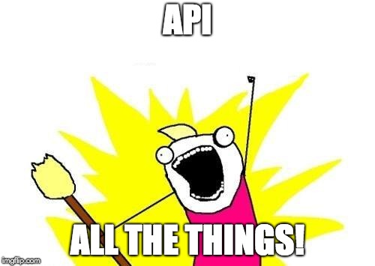
Infinity APIs
80.10 API
GAIA API
Identity Awareness API
Threat API
Generic API
sk121360

Slide 21
The Beginners Guide to API
(mgmt_cli)

Slide 22
Always remember the flow
Login
Send Rest Action
Publish
Logout
https://<mgmt>/web_api/login
https://<mgmt>/web_api/add-host
https://<mgmt>/web_api/publish
https://<mgmt>/web_api/logout
Install Policy
https://<mgmt>/web_api/install_policy

Slide 23
MGMT_CLI
Built into 80.10 can be used to execute commands from expert mode
Installed by default as part of SmartConsole
Can be installed on any Windows Machine
It is mandatory to provide login credentials or use a session-id token that was obtained previously using the ‘login’ command.
Mgmt_cli –r true

Slide 24
Session-ID
In the GUI, you start with a login dialog and everything that you do is later associated with your “session”.
mgmt_cli login user api_user password vpn123
sid: "n6WWLtG_5fErplyLuRA50sgVZy8qjeuh01tf5NeEmKg“ url: "https://127.0.0.1:443/web_api" uid: "82e6a475-435b-4761-a572-74b19128a776“ session-timeout: 600

Slide 25
Passing Credentials
# mgmt_cli add host name minion2 ip-address 2.2.2.2
Username: api_user
Password:
# mgmt_cli add host name minion3 ip-address 3.3.3.3 –u RandomTask
Password:
# mgmt_cli add host name minion4 ip-address 4.4.4.4 –u RandomTask –p coffee
When not using a defined session, “Login” and “Publish” happen implicitly
Mgmt_cli –r true

Slide 26
Example Command
Simply create a new host
mgmt_cli add host name minion1 ip-address 1.1.1.1
mgmt_cli add host name minion1 ip-address 1.1.1.1
mgmt_cli add host name minion1 ip-address 11.11.11.11
Command
Key value
(always come in pairs)

Slide 27
Let’s Automate a task…
Login and create a new host
mgmt_cli login user api_user password vpn123 > id.txt
mgmt_cli add host name minion1 ip-address 11.11.11.11 –s id.txt
mgmt_cli publish –s id.txt
mgmt_cli logout –s id.txt

Slide 28
The components: Command
Login and create a new host
mgmt_cli login user api_user password vpn123 > id.txt
mgmt_cli add host name minion1 ip-address 11.11.11.11 –s id.txt
mgmt_cli publish –s id.txt
mgmt_cli logout –s id.txt
Command name

Slide 29
The components: Key
Login and create a new host
mgmt_cli login user api_user password vpn123 > id.txt
mgmt_cli add host name minion1 ip-address 11.11.11.11 –s id.txt
mgmt_cli publish –s id.txt
mgmt_cli logout –s id.txt
Key value
(always come in pairs)

Slide 30
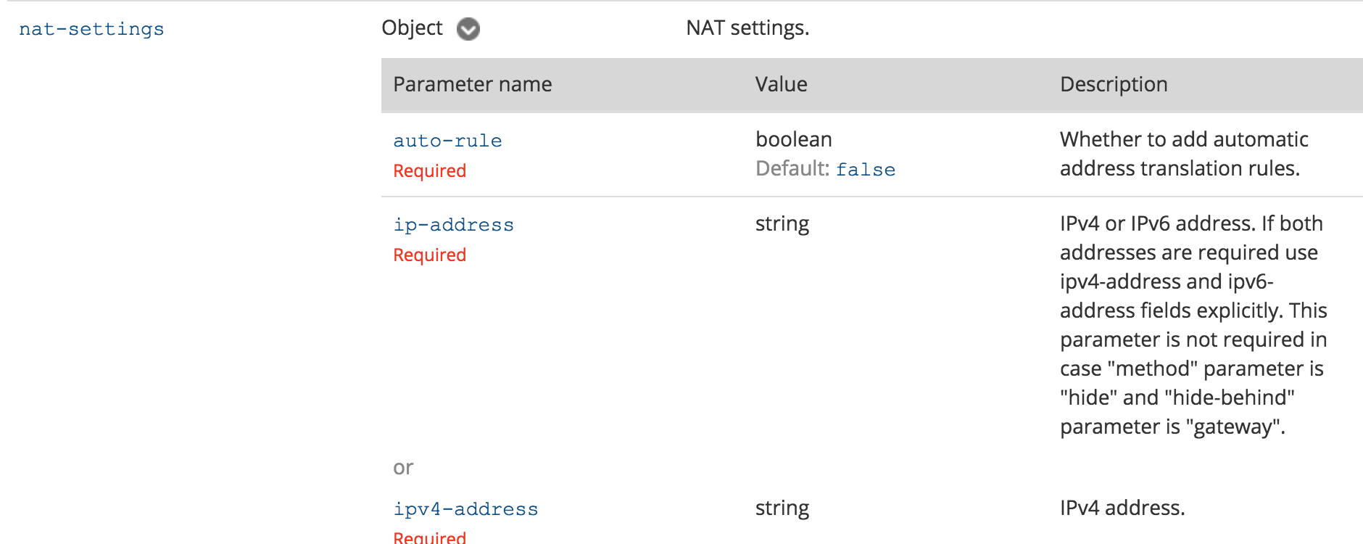
Bonus component: Key “Options”
add host name "New Host 3" ip-address "192.0.2.162" nat-settings.auto-rule true nat-settings.method "hide" nat-settings.hide-behind "ip-address" nat-settings.ipv4-address "192.0.2.1"
Key option value
(always come in pairs)

Slide 31
The components: Switches
Login and create a new host
mgmt_cli login user api_user password vpn123 > id.txt
mgmt_cli add host name minion1 ip-address 11.11.11.11 –s id.txt
mgmt_cli publish –s id.txt
mgmt_cli logout –s id.txt
mgmt_cli switches (they are not arguments of the command)

Slide 32
One more important note…
Unlike dbedit, mgmt_cli does not prompt for management IP - It defaults to 127.0.0.1
To direct it to a remote IP, use either:
[--management, -m] Management server IP address / hostname (SMS Only)
[--domain, -d] Domain server IP address / hostname (MDS or SMS)
Environment variable: MGMT_CLI_MANAGEMENT
C:> mgmt_cli login -u api_user -p vpn123
Couldn't connect to server
C:>mgmt_cli login -u api_user -p vpn123 -m 10.0.0.49
sid: "Tn3eXnB1_DlLbk9MvIlEY3Hc3SGwUigt4DpC94-DIg8"
url: "https://hollywood-sm01:443/web_api"
uid: "74b817ed-f561-43a6-890c-d43bfd256822"
session-timeout: 600
last-login-was-at:
posix: 1455259540267
iso-8601: "2016-02-12T08:45+0200"
login-message:
header: "Warning - MiniMe takes security seriously"
message: "Authorized access only. Violators will be fed to sharks"

Slide 33
But wait… There’s more! Working in batch mode
Build a CSV. The columns will be the keys, with rows as values…
Execute against it
There is no 3. That’s it!
# cat minions.csv
name,ip-address,color
minion1,1.1.1.1,yellow
minion2,1.1.1.2,yellow
minion3,1.1.1.3,yellow
minion4,1.1.1.4,yellow
minion5,1.1.1.5,yellow
minion6,1.1.1.6,yellow
# mgmt_cli add host --batch minions.csv

Slide 34
Let’s Lab Some Stuff!
API Guide
https://tinyurl.com/yakbvnbp
Make a ”Host” object
Create a ”Group” object and add your new ”Host” to it
Create a “Network” object and enable ”Auto NAT Hide Behind Gateway”
Create a “BATCH” import using CSV of at least 10 ”Host” objects
Add them all to the group you made in # 2
Delete it all

Slide 35
Advanced SHELL Scripting

Slide 36
PRINTF/ECHO/Read/Variables - Interactive
printf "This script will search a specific policy package for rules with a ZERO hit count.\nUse with caution for deleting rules..\nIf for any reason you make a typo and need to exit use CTRL+C.\nPress ENTER to continue”
read ANYKEY
echo Listing Access Policy Package Names.
mgmt_cli -r true show access-layers --format json | jq --raw-output '."access-layers"[] | (.name)’
echo What is the Policy Package Name?
read POL_NAME
mgmt_cli -r true show access-rulebase name "$POL_NAME" details-level "standard" use-object-dictionary true show-hits true --format json

Slide 37
Seq loop
for I in $(seq 1 10)
do
mgmt_cli -r true add host name Host-$I ip-address 192.168.100.$I
done

Slide 38
BONUS TIP!

Slide 39
SED
Used to transform and parse text
sed 's/regexp/replacement/g' inputFileName > outputFileName
^ - matches the beginning of the line
$ - matches end of the line
Fully support regex
sed "s/^/mgmt_cli -r true -d $DOMAIN/" $POL2-tmp2.txt > $POL2-delete-unused.txt

Slide 40
Order of Operations
Groups
Hosts
Networks
Rules
Etc…

Slide 41
Let’s do Shell Scripting Labs!
Create a script that will ask for the ”NAME” and “IP-Address” of a host object.
Create a Script to make 50 HOST objects using a loop
Create a Script that uses a loop to create 50 Host objects and the name uses a input variable from a echo/read command.
Delete it all!
Chmod 777 script_name.sh
./script_name.sh

Slide 42
JSON and JQ

Slide 43

JSON – JavaScript Object Notation
Lightweight data interchange format
Created in 1999
“Easy” to read/write
Easy to parse
JSON is text only

Slide 44
JSON and 80.10
JSON can be used as an output to mgmt_cli or SmartConsole CLI commands
Provide the flag “--format json” to the command
Output will be proper JSON format
Using the WebServices API all input is JSON formated

Slide 45
JSON – Example Output
mgmt_cli -r true show unused-objects --format json
{
"objects" : [ {
"uid" : "65846238-7556-45c7-989c-63a3750c704e",
"name" : "group1",
"type" : "group",
"domain" : {
"uid" : "41e821a0-3720-11e3-aa6e-0800200c9fde",
"name" : "SMC User",
"domain-type" : "domain"
}
That’s great…
What am I even supposed to do with that?

Slide 46
JSON – What now?!?
When used with a shell script we could use grep.
Could use sed/awk
What if we want multiple elements from the output?
What if we want to manipulate the text?

Slide 47
Enter ‘jq’
jq is a lightweight and flexible command-line JSON processor
jq is like sed for JSON data
jq can mangle the data format that you have into one that you want ☺
R80.X includes jq
Allows for easy data manipulation
Can be used to filter data when the R80 API does not allow

Slide 48
JQ – Example - Filtering
mgmt_cli -r true show unused-objects --format json | jq --raw-output '.objects[] | select(.type == ”group")'
{
"uid": "65846238-7556-45c7-989c-63a3750c704e",
"name": "group1",
"type": "group",
"domain": {
"uid": "41e821a0-3720-11e3-aa6e-0800200c9fde",
"name": "SMC User",
"domain-type": "domain"
}
}

Slide 49
Now Let’s Manipulate the Data
mgmt_cli -r true show unused-objects --format json | jq --raw-output '.objects[] | select(.type == ”group")
mgmt_cli -r true show unused-objects --format json | jq --raw-output '.objects[] | select(.type == ”group") | ("mgmt_cli -r true delete group name " + .name)' >delete-unused-hosts.txt
mgmt_cli -r true delete group name group1
mgmt_cli -r true delete group name group2
mgmt_cli -r true delete group name group3
mgmt_cli -r true delete group name New Group
mgmt_cli -r true delete group name New Group 5
{
"uid": "65846238-7556-45c7-989c-63a3750c704e",
"name": "group1",
"type": "group",
"domain": {
"uid": "41e821a0-3720-11e3-aa6e-0800200c9fde",
"name": "SMC User",
"domain-type": "domain"
}group}

Slide 50
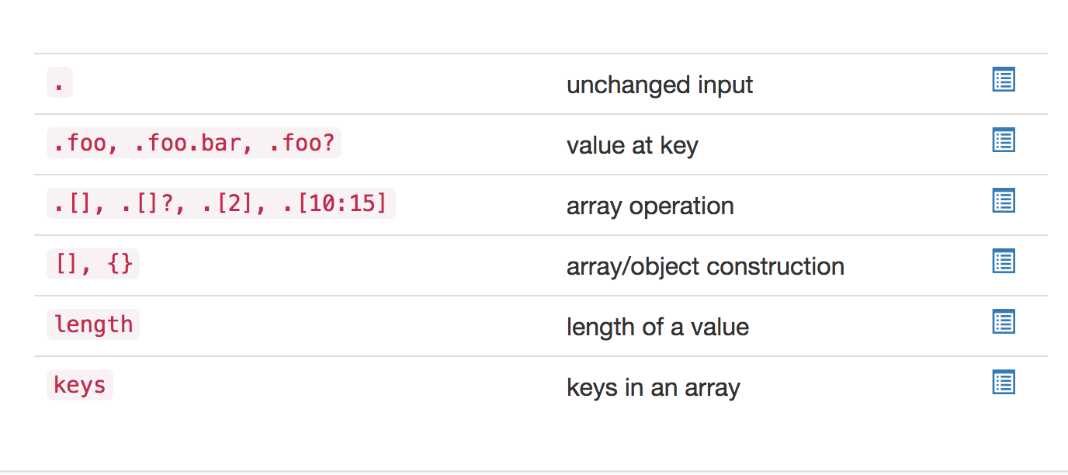
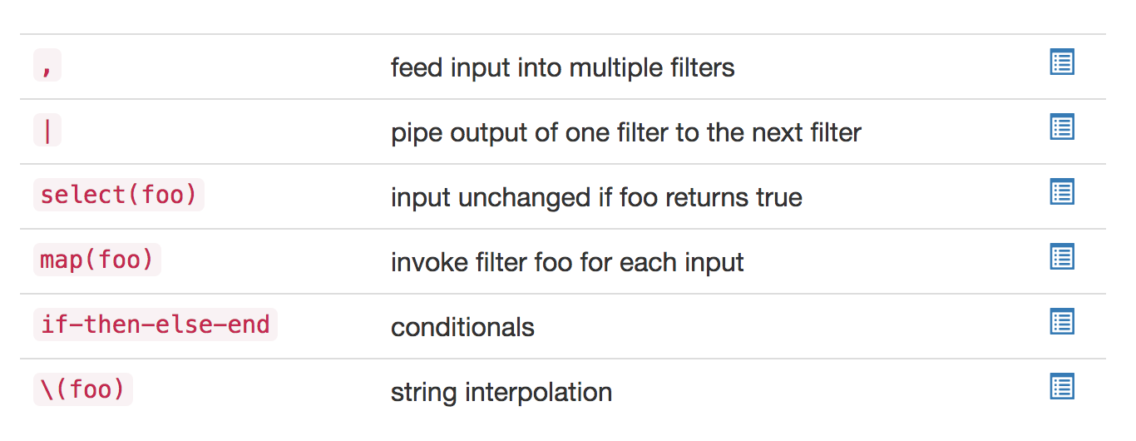
JQ - Options

Slide 51
More JQ
JQ Play
https://jqplay.org/
JQ Select Command
select(."installation-targets" == "all" |not)
select(.type=="simple-gateway")
Passing Variables to JQ
mgmt_cli -r true show access-rulebase name "$POL_NAME" details-level "standard" use-object-dictionary true show-hits true --format json | jq --raw-output --arg RBN "$POL_NAME" '.rulebase[]

Slide 52
JQ – RAW Output
mgmt_cli -r true show unused-objects --format json | jq --raw-output '.objects[] | select(.type == "group") | ("mgmt_cli -r true delete group name " + .name)'
Formats into standard output instead of “ “ json output

Slide 53
JQ LABS
Create 10 ”NETWORK” Objects
Make 5 with AUTO Hide Nat Behind the Gateway Enabled
Make 5 with no NAT
HINT: Use your LOOPS from the last section to make this easy
Create a Script that will output the proper MGMT_CLI commands to delete the networks that have no AUTO NAT enabled.
HINT: Pay attention to the “Details-level” on your ‘show networks’ command
Use the API Guide
Use JQPLAY.org to filter your json
Notes:
mgmt_cli -r true show networks limit 50 offset 0 details-level "full" --format json |jq --raw-output '.objects[] | select(."nat-settings"."auto-rule"==true) | ("mgmt_cli -r true delete network name ") + (.name)'

Slide 54
Orchestration
&
Ansible

Slide 55
Ansible – What is it???
Ansible is a radically simple automation engine that automates many IT needs including the following
Cloud Provisioning
Configuration management
Application deployment
Intra-service orchestration
Commands are send to the end modules via SSH
Modules are available to make Ansible extensible
Many are included by default
Check Point’s module is not currently included by default

Slide 56
Ansible – What is it???
Ansible uses an inventory system
Simple Text Files (/etc/ansible/hosts)
Dynamic Inventory – think AWS, Azure, or OpenStack
Ansible Playbooks are used to orchestrate move/add/changes
Multiple tasks can be run in a Playbook
Playbooks can be combined
Ansible is driven by Python
Ansible playbooks are written in YAML

Slide 57
Ansible – YAML Ain’t Markup Language (YAML)
YAML - http://www.yaml.org/spec/1.2/spec.html
YAML and JSON aim to be human readable as a data interchange format
YAML can be easier for humans to read
YAML is similar to Python and indentation-based scoping is used
YAML has no direct correlation to XML

Slide 58
Ansible – Compare JSON to YAML – JSON First
{
"last-updated" : {
"posix" : 1515001214000,
"iso-8601" : "2018-01-03T17:40+0000"
},
"installed-version" : "635180014",
"installed-version-creation-time" : {
"posix" : 1514815200000,
"iso-8601" : "2018-01-01T14:00+0000"
},
"update-available" : true,
"latest-version" : "635180084",
"latest-version-creation-time" : {
"posix" : 1515067200000,
"iso-8601" : "2018-01-04T12:00+0000"
}
}

Slide 59
Ansible – Compare JSON to YAML – Now YAML
---
last-updated:
posix: 1515001214000
iso-8601: 2018-01-03T17:40+0000
installed-version: '635180014'
installed-version-creation-time:
posix: 1514815200000
iso-8601: 2018-01-01T14:00+0000
update-available: true
latest-version: '635180084'
latest-version-creation-time:
posix: 1515067200000
iso-8601: 2018-01-04T12:00+0000

Slide 60
Ansible – Using YAML
Don’t be a rookie and use tabs
Tabs are evil - use spaces for spacing in YAML files – quick example
---
- hosts: "192.168.1.1"
gather_facts: no
connection: local
tasks:
- name: "set shell"
raw: set user admin shell /bin/bash
- name: "save config"
raw: save config
- name: Waiting for 65 seconds to clear SSH session
pause:
seconds: 65

Slide 61
Ansible – Using YAML with variables
Ansible can include files that will be used as variables as part of the play
Variables are denoted by the double curly braces - {{ my_variable }}
When running a play a flag of --extra-vars can be added to the run to pass variables from the cli
Some variables can also come from an environment variable
Common uses are cloud credentials
Variables can also be included from the /etc/ansible/hosts
Review the /etc/ansible/hosts on your lab machines
Check for the [Gaia:vars] section

Slide 62
Ansible – Idempotence
Now to the important part –
The Check Point Ansible module does not support Idempotence…………….
What does that mean to us????
Be careful when you run a playbook
We must understand the state of the database and what we want to do
If an object already exists for example the playbook will fail since the module does not compare the existing state to the new state

Slide 63
Ansible – Check Point Module
Updated Ansible module can be found here
https://github.com/CheckPoint-APIs-Team/cpAnsible
Instructions on install are part of this GitHub site
Requires the Check Point API Python SDK

Slide 64
Always remember the flow
Login
Send Rest Action
Publish
Logout
https://<mgmt>/web_api/login
https://<mgmt>/web_api/add-host
https://<mgmt>/web_api/publish
https://<mgmt>/web_api/logout
Install Policy
https://<mgmt>/web_api/install_policy

Slide 65
Ansible – Simple Ansible Example - Login
---
- hosts: "localhost"
vars_files:
- vars.yml
- vars-vmware.yml
tasks:
- name: "login"
check_point_mgmt:
command: login
parameters:
username: "{{mgmt_user}}"
password: "{{mgmt_password}}"
management: "{{mgmt_server}}"
fingerprint: "{{mgmt_fingerprint}}"
register: login_response

Slide 66
Ansible – Simple Ansible Example – Do Something
- name: "Add Host"
check_point_mgmt:
command: add-host
parameters:
name: "CHKP-Hide"
ip-address: "{{ perimeter_gw_external_ip }}"
color: "red"
session-data: "{{login_response}}"

Slide 67
Ansible – Simple Ansible Example – Publish
- name: "publish"
check_point_mgmt:
command: publish
session-data: "{{login_response}}"

Slide 68
Ansible – Simple Ansible Example – Logout
- name: "logout"
check_point_mgmt:
command: logout
session-data: "{{login_response}}"

Slide 69
Ansible – Loops!
- name: "Create Hosts"
check_point_mgmt:
command: add-host
parameters:
name: "mytesthost_{{ item }}"
ipv4-address: "10.123.123.{{item}}"
color: blue
session-data: "{{login_response}}"
with_sequence: start=1 end=254

Slide 70
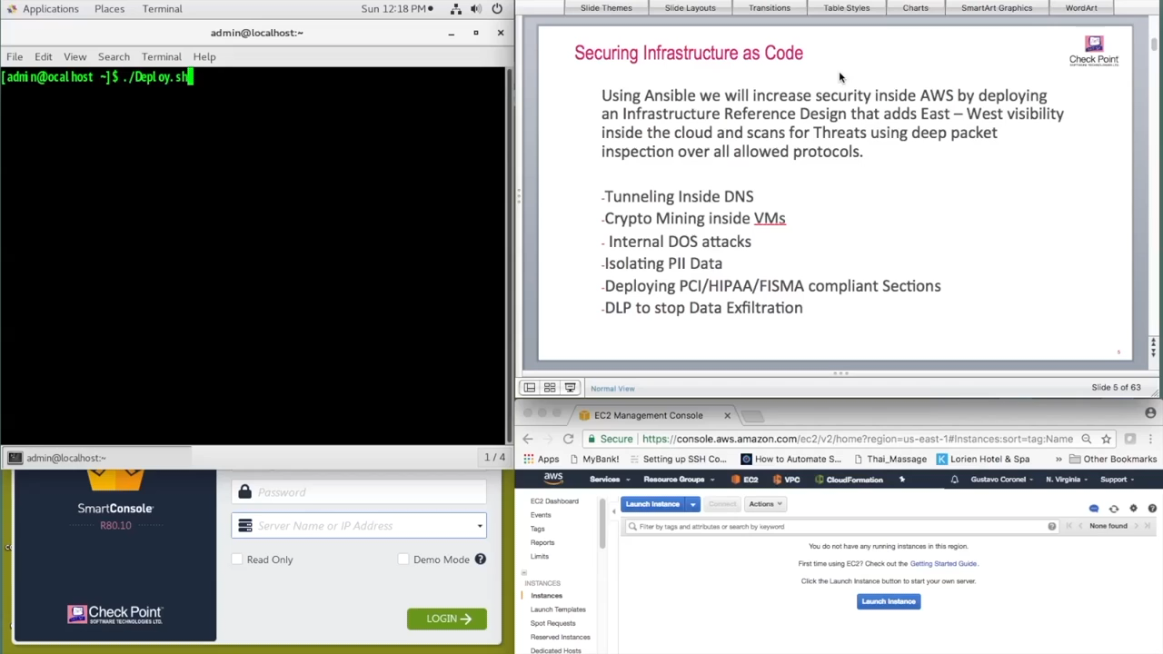

Slide 71


Slide 72
THANK YOU

